Slide 1
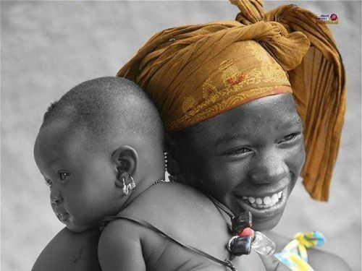
PRESENT’S SAFE HAVEN
GROUP 1 (FUSION GIRLS)

Slide 2
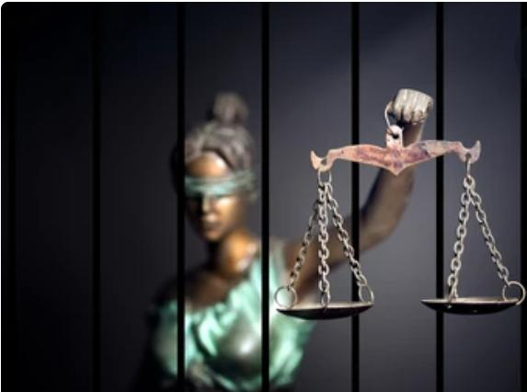
Project Outline
● About the project
● SDGs'S considered
● Vision and Mission
● Plan to achieve the dream
● Mandate
● Solution model
● Landing page
● Team Members

Slide 3
What is safe haven?
Safe Haven is an online platform or community that supports women and girls who have experienced or are suffering from female genital mutilation (FGM) and child marriage. This solution focuses on the girl child’s traumas, especially those influenced by tradition and ancestral beliefs.

Slide 4
Gender Equality Reduced inequalities Peace ,justice and strong institution
SDGS Considered
5
10
16

Slide 5
The Problem
The UN estimates that 200 million women and girls have had female genital mutilation (FGM), and 80 percent of them are Africans.
FGM is an extreme form of discrimination against women and represents deep-rooted inequality between the sexes.
Every year, at least 12 million girls are married before they reach the age of 18. This amounts to 28 girls per minute.
Sub-Saharan Africa has a staggering 40 percent of girls marrying before they turn 18, and 15 of the 20 countries with the highest child marriage rates are African countries

Slide 6
Vision and Mission
To become a ray of hope for the victims
To establish contact and be the victim’s first call in case of danger.
To offer a place of comfort for all victims

Slide 7
.
PLAN TO ACHIEVE THE DREAM
● To create a platform easily accessible to victims to share their stories and seek help
● Partner with Non-Governmental Organizations to make sure victims are taken care of
● Work with justice Institutions to ensure that the right of all is protected.

Slide 8
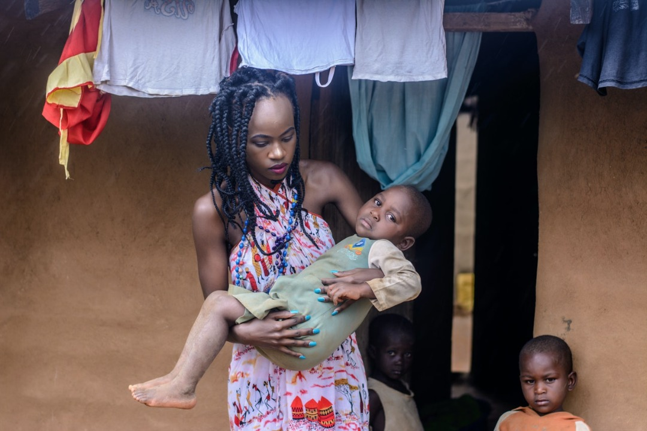
Mandate
Focus 1:
We seek to enlighten people on the dangers of female genital mutilation and child marriage.
Focus 2:
We seek to reduce violence against women, in and outside marriages.

Slide 9
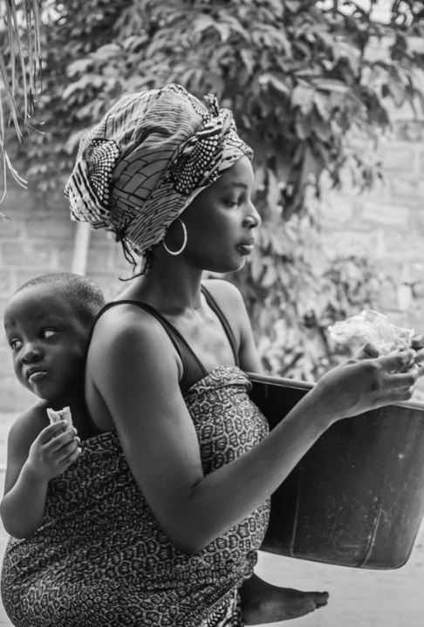
FOCUS 3
We strive to provide a place of solace to victims, becoming their first point of contact during danger.

Slide 10
Solution Model What we want to achieve:
To make gender inequality a thing of the past
To promote the self esteem of females who must have suffered from abuse, of any kind.
To become the first point of call in the case of an abuse or danger

Slide 11
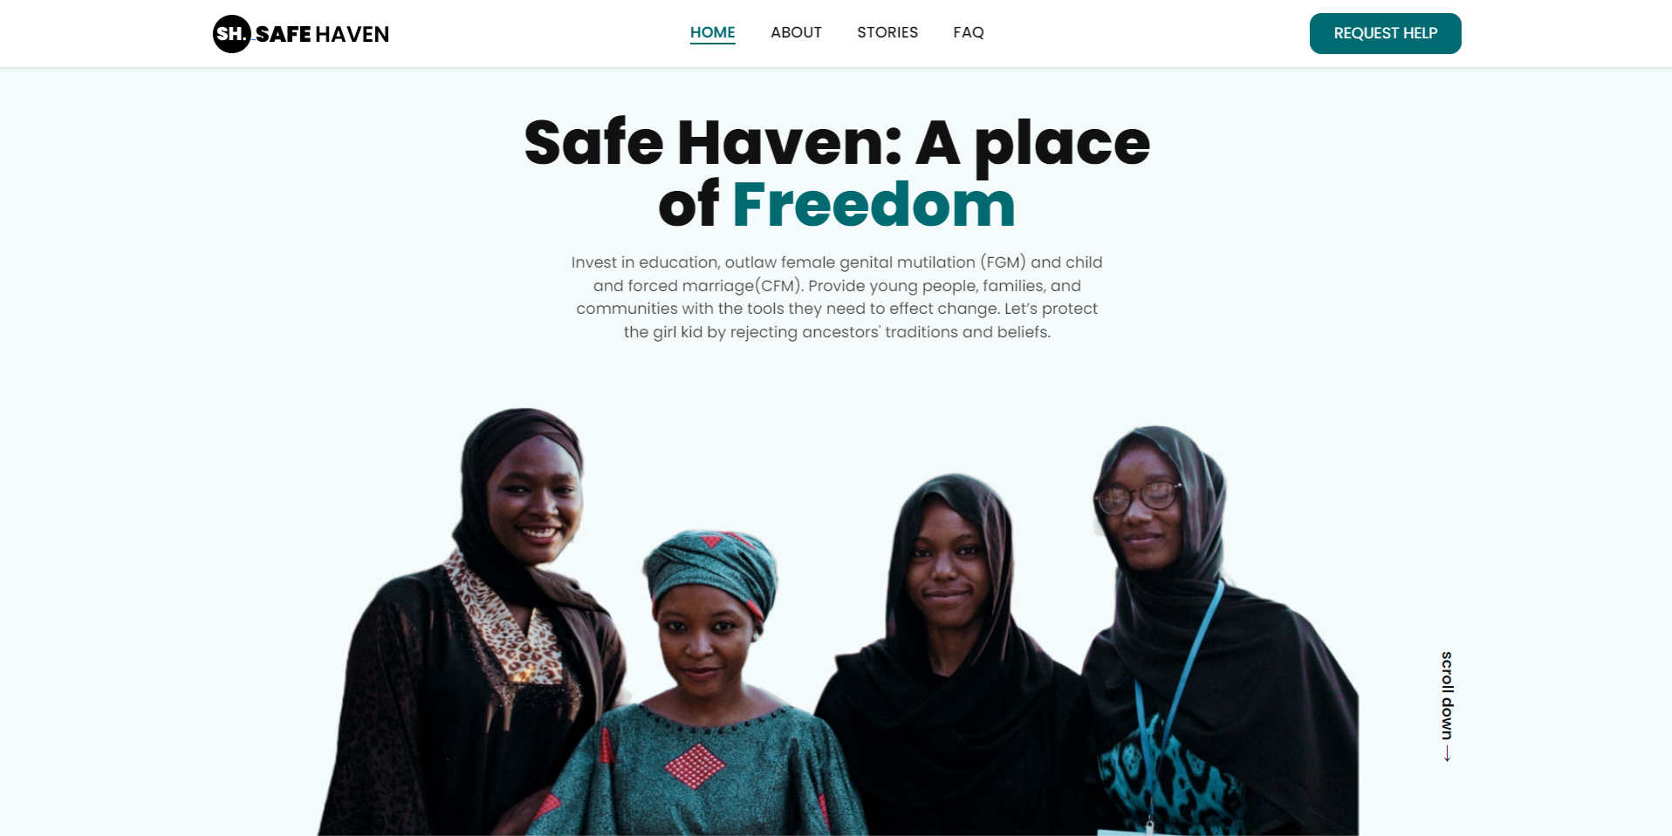
PLATFORM’S LANDING PAGE

Slide 12

TEAM MEMBERS
TEAM LEAD
Diana Etuk
ASSISTANT LEAD
Temitope Okesanya
Lilian Mwongeli Mutua
George Elizabeth Ibitroko
Linda Ochem
Omoniyi Folashade

Slide 13

Joy Ibeh
Oruta Delight Adannaya
Okoli Juliet
Ighofoimoni Elo Mercy
Olanike Odunfa
Beautitude Umoh
Ossai Grace
Ojiteli Kosisochukwu Vivan

